Slide 1


Intro to Git & GitHub
Week 4

Slide 2
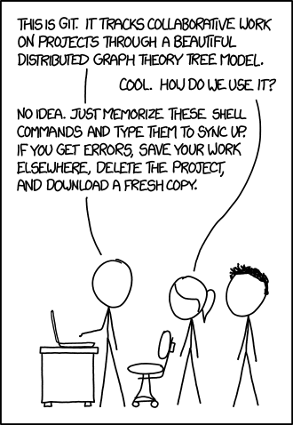

Slide 3
What is Git and GitHub?

Slide 4
What is Git?
Git is an Open Source Distributed Version Control System.
Control System: This basically means that Git is a content tracker. So Git can be used to store content — it is mostly used to store code due to the other features it provides.
Version Control System: The code which is stored in Git keeps changing as more code is added. Also, many developers can add code in parallel. So Version Control System helps in handling this by maintaining a history of what changes have happened. Also, Git provides features like branches and merges, which I will be covering later.

Slide 5
What is Git?
Distributed Version Control System: Git has a remote repository which is stored in a server and a local repository which is stored in the computer of each developer. This means that the code is not just stored in a central server, but the full copy of the code is present in all the developers’ computers. Git is a Distributed Version Control System since the code is present in every developer’s computer. I will explain the concept of remote and local repositories later in this article.

Slide 6
Why is Git Needed?
Real life projects generally have multiple developers working in parallel. So a version control system like Git is needed to ensure there are no code conflicts between the developers.
Additionally, the requirements in such projects change often. So a version control system allows developers to revert and go back to an older version of the code.
Finally, sometimes several projects which are being run in parallel involve the same codebase. In such a case, the concept of branching in Git is very important.

Slide 7
Git vs GitHub: What’s the difference?
Git is a revision control system, a tool to manage your source code history.
GitHub is a hosting service for Git repositories.
So they are not the same thing: Git is the tool, GitHub is the service for projects that use Git.

Slide 8
Setting Up Git

Slide 9
Git Setup
Git is primarily used via the command-line interface, which we can access with our system terminals.
However, we first need to make sure that we have Git installed on our computers.
You can download git here: https://git-scm.com/downloads

Slide 10
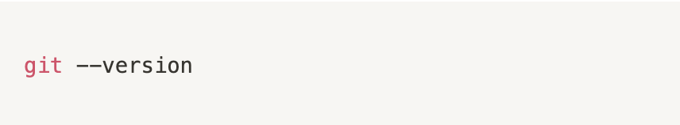
Check if Git is Installed
Click the download link for your specific operating system and then follow through the installation wizard to get things set up on your computer!
After installing it, start your terminal and type the following command to verify that Git is ready to be used on your computer:

Slide 11
Terminal
If you are using a Mac or Linux machine, then you can utilize the default Bash terminal that comes pre-installed on your machine.
If you are using Windows, you can use its built-in Powershell terminal, or the Git Bash terminal which is bundled with the Git installation. For detailed windows Git and Git Bash install instructions, check out this blog post: https://zarkom.net/blogs/how-to-install-git-and-git-bash-on-windows-9140

Slide 12
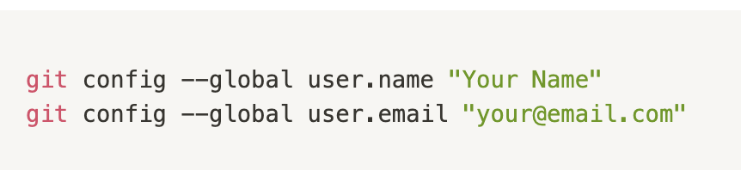
Configuring Name and Email
In your terminal, run the following commands to identify yourself with Git. Replace the values inside the quotes with your name and email address:

Slide 13
Repositories

Slide 14
What is a Repository?
When working with Git, it's important to be familiar with the term repository. A Git repository is a container for a project that is tracked by Git.
We can single out two major types of Git repositories:
Local repository - an isolated repository stored on your own computer, where you can work on the local version of your project.
Remote repository - generally stored outside of your isolated local system, usually on a remote server. It's especially useful when working in teams - this is the place where you can share your project code, see other people's code and integrate it into your local version of the project, and also push your changes to the remote repository.
In this tutorial, we'll only work with local repositories.

Slide 15
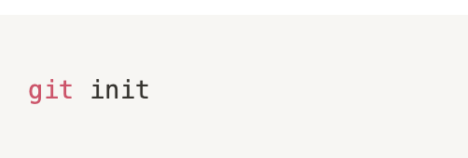
Initializing a Repository
To create a new repository and start tracking your project with Git, use your terminal software and navigate to the main folder of your project, then type the following command:
This command will generate a hidden .git directory for your project, where Git stores all internal tracking data for the current repository.

Slide 16
Staging and Committing Code

Slide 17
What is a Commit?
Committing is the process in which the changes are 'officially' added to the Git repository.
In Git, we can consider commits to be checkpoints, or snapshots of your project at its current state. In other words, we basically save the current version of our code in a commit. We can create as many commits as we need in the commit history, and we can go back and forth between commits to see the different revisions of our project code. That allows us to efficiently manage our progress and track the project as it gets developed.
Commits are usually created at logical points as we develop our project, usually after adding in specific contents, features or modifications (like new functionalities or bug fixes, for example). Before we can commit our code, we need to place it inside the staging area.

Slide 18
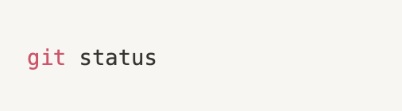
Checking the Status
While located inside the project folder in our terminal, we can type the following command to check the status of our repository:
This is a command that is very often used when working with Git. It shows us which files have been changed, which files are tracked, etc.
We can add the untracked project files to the staging area based on the information from the git status command.
At a later point, git status will report any modifications that we made to our tracked files before we decide to add them to the staging area again.

Slide 19
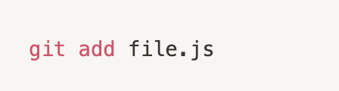
Staging Files
From the project folder, we can use the git add command to add our files to the staging area, which allows them to be tracked.
We can add a specific file to the staging area with the following command:

Slide 20
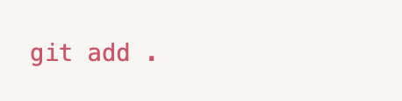
Staging all Files
Instead of having to add the files individually, we can also add all the files inside the project folder to the staging area. By default, this adds all the files and folders inside the project folder to the staging area, from where they are ready to be committed and tracked.

Slide 21
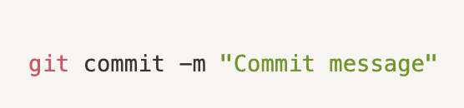
Making Commits
A commit is a snapshot of our code at a particular time, which we are saving to the commit history of our repository. After adding all the files that we want to track to the staging area with the **git add** command, we are ready to make a commit.

Slide 22
Making Commits
Inside the quotes, we should write a commit message which is used to identify it in the commit history.
The commit message should be a descriptive summary of the changes that you are committing to the repository.
After executing that command, you will get the technical details about the commit printed in the terminal. And that's basically it, you have successfully made a commit in your project!

Slide 23
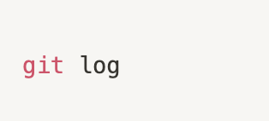
Commit History
To see all the commits that were made for our project, you can use the following command. The logs will show details for each commit, like the author name, the generated hash for the commit, date and time of the commit, and the commit message that we provided.

Slide 24
Pushing Code to GitHub

Slide 25
Pushing to GitHub
Here we will be using GitHub for the remote repository.
Go to https://github.com/ and create an account.
After registering in the GitHub homepage, click on Start a Project to create a new Git repository. Give the repository a name and click “Create Repository”
Give it a name. This will create a remote repository in GitHub, and when you open the repository, a page like the image below will open up:

Slide 26
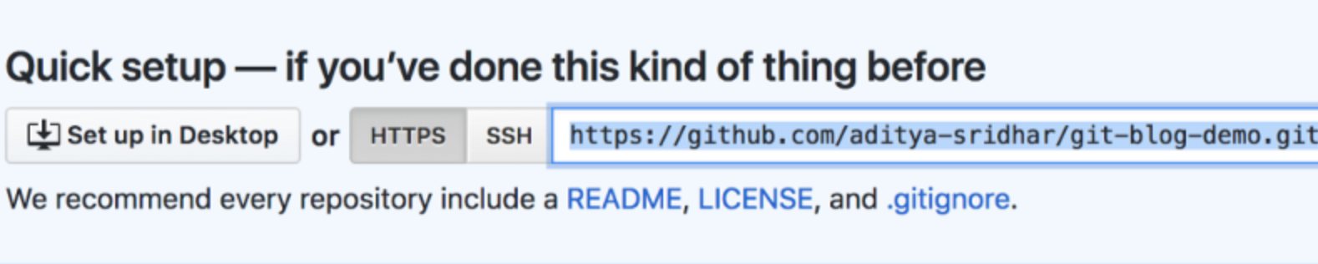
Pushing to GitHub
The repository URL is the highlighted portion https://github.com/aditya-sridhar/git-blog-demo.git

Slide 27

Pushing to GitHub
In order to point your local repository to the remote repository, use the following command:

Slide 28

Git Push
In order to push all the code from the local repository into the remote repository, use the following command. This pushes the code from the master branch in the local repository to the master branch in the remote repository.

Slide 29

Git Pull
Git Pull is used to pull the latest changes from the remote repository into the local repository. The remote repository code is updated continuously by various developers, hence git pull is necessary:

Slide 30

Git Clone
Git clone is used to clone an existing remote repository into your computer. The command for this is:

Slide 31
Branches

Slide 32
What is a Branch?
A branch could be interpreted as an individual timeline of our project commits.
With Git, we can create many of these alternative environments (i.e. we can create different branches) so other versions of our project code can exist and be tracked in parallel.
That allows us to add new (experimental, unfinished, and potentially buggy) features in separate branches, without touching the 'official' stable version of our project code (which is usually kept on the master branch).
When we initialize a repository and start making commits, they are saved to the master branch by default.

Slide 33
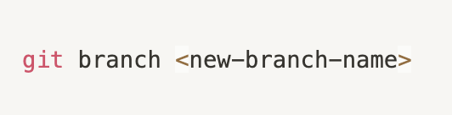
Creating a Branch
You can create a new branch using the following command. It's a good idea to create a development branch where you can work on improving your code, adding new experimental features, and similar. After development and testing these new features to make sure they don't have any bugs and that they can be used, you can merge them to the master branch.

Slide 34
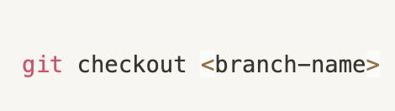
Changing Branches
To switch to a different branch, you use the git checkout command. For example, you could be working on different features in your code and have a separate branch for each feature. When you switch to a branch, you can commit code changes which only affect that particular branch. Then, you can switch to another branch to work on a different feature, which won't be affected by the changes and commits made from the previous branch.

Slide 35
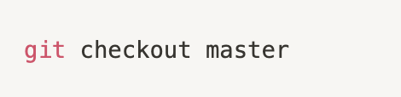
Changing Branches
To go back to the master branch, use this command:

Slide 36
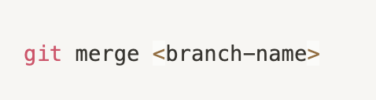
Merching Branches
You can merge branches in situations where you want to implement the code changes that you made in an individual branch to a different branch.
For example, after you fully implemented and tested a new feature in your code, you would want to merge those changes to the stable branch of your project (which is usually the default master branch).
To merge the changes from a different branch into your current branch, you can use this command. You would replace <branch-name> with the branch that you want to integrate into your current branch.

Slide 37
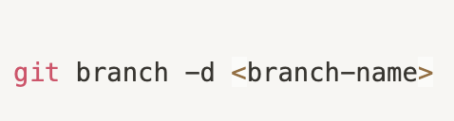
Deleting a Branch
To delete a branch, you can run the git branch command with the -d flag:

Slide 38
Add Your Code to the GirlScript Repo

Slide 39
How to add games to Gaming Booster Repo
Fork the Repo: https://github.com/GirlScript-Ireland/Gaming-Booster
Clone the Repo on your terminal: git clone
Cd into the the gaming-booster folder on terminal
Put your games in your folder with your name within Nicole’s Team
On your terminal, type git add .
On your terminal, type git commit -m “add your message”
On your terminal, type git push -u origin master
On Github, in your Gaming-Booster repo, click pull-request, add a title then click create pull request

Slide 40
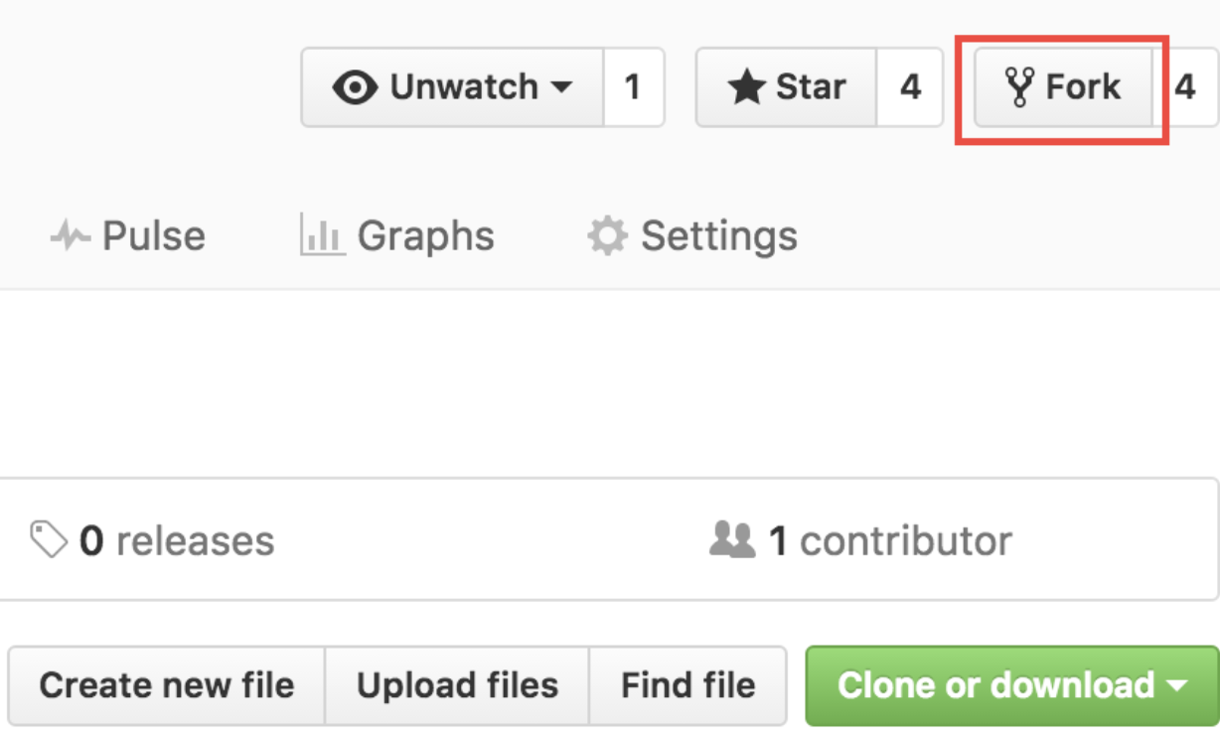
Forking a Repo

Slide 41
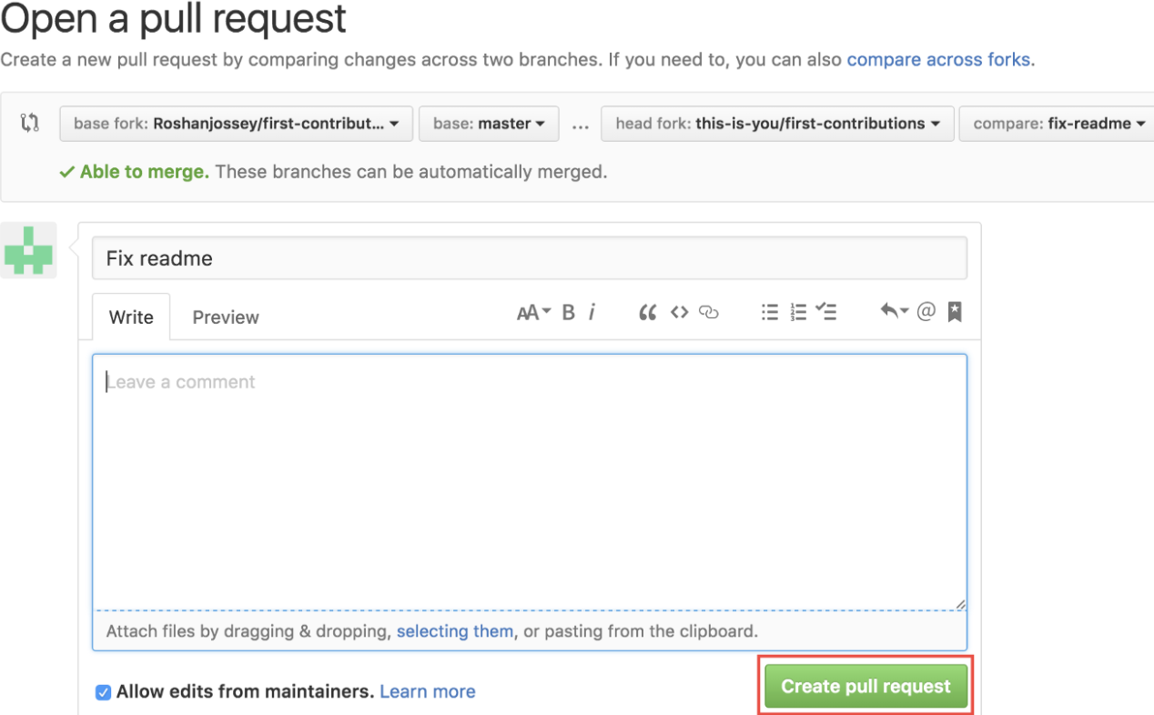
Creating a Pull Request

Slide 42
Further Resources

Slide 43
Git Resources
Git official documentation: https://git-scm.com/doc
The free Pro Git book: https://git-scm.com/book/en/v2
Learn about GitHub: https://guides.github.com/

